Slide 1

HOME LOANS
AND
MACHINE LEARNING
June 2023

Slide 2
AGENDA
Data Science Lifecycle​
Project Overview​
Data
Analysis
Modeling
Model Evaluation
Recommendations
2

Slide 3
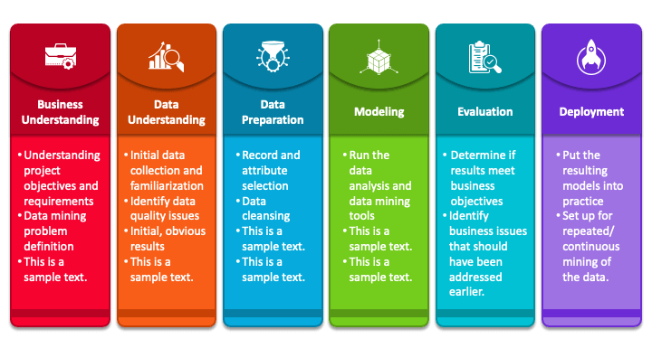
Data Science Lifecycle
1
2
3
4
5
6
Utilising the CRISP-DM model we identify the following phases of the data science lifecycle
3

Slide 4

PROJECT OVERVIEW
OPPORTUNITY:
Currently it takes approximately 2 to 3 days for applicants of home loans to receive the outcome of their application.
OBJECTIVE:
To speed up the home loan assessment process by making use of machine learning and automated machine learning to provide applicants with the outcome of their application in a matter of seconds.
SOLUTION:
Implementing machine learning and automated machine learning to estimate a future applicant's home loan status based on historical data in order to greatly the latency between when the application is submitted, and the outcome received.
4

Slide 5
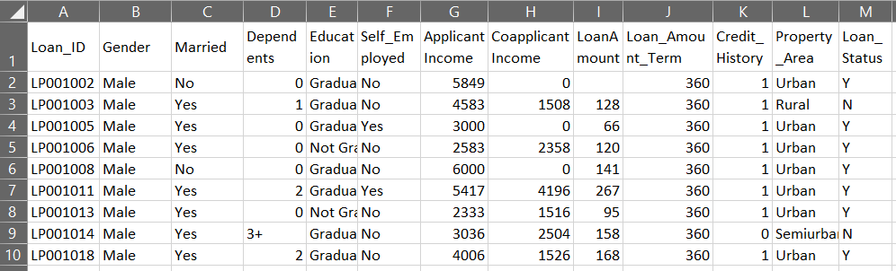
DATA
Data
Repository
Training Dataset
This dataset is used to train the models on and consist of historical data.
This dataset exhibits similar characteristics as the training dataset and is used to test the models on.
Testing
Dataset
614 rows x 13 columns
Target Variable
Snapshot of the Dataset
368 rows x 12 columns
5

Slide 6
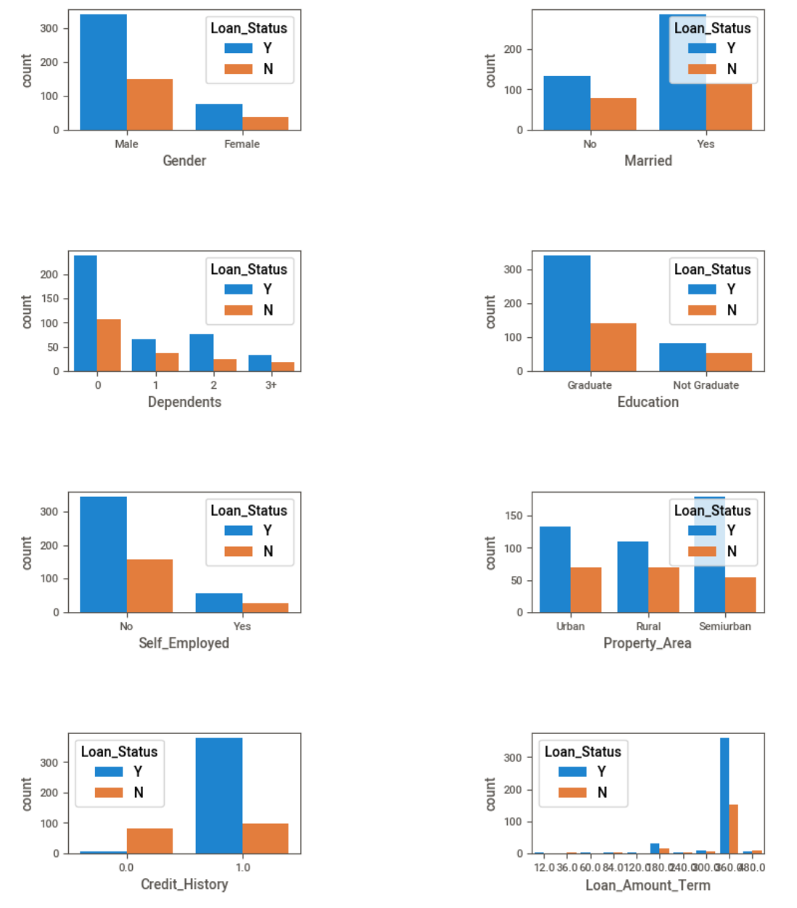
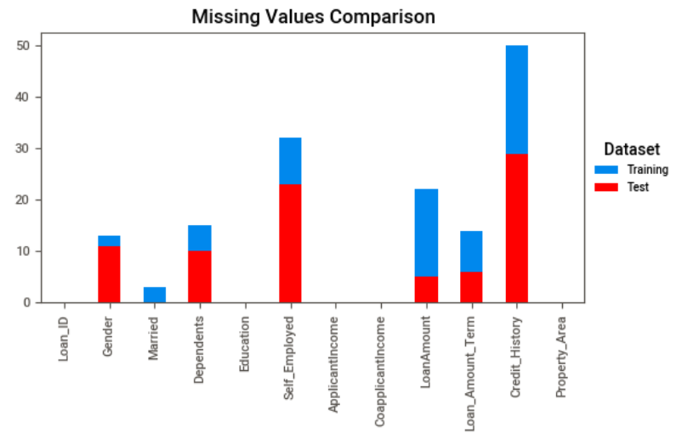
ANALYSIS
Distribution of Missing Values
Distributions Loan Status vs Other Indicators
6

Slide 7
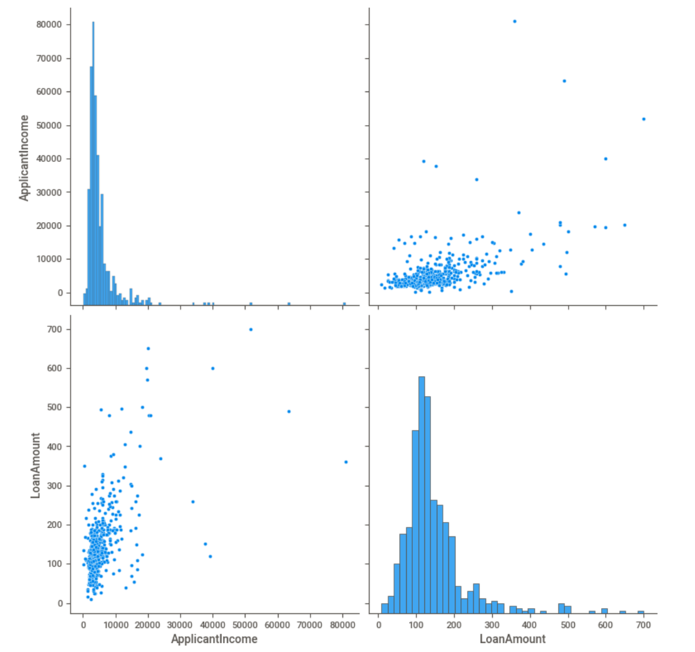
ANALYSIS
Positive Correlation Between The Applicant’s Income And The Loan Amount Applied For
Individuals with Credit History more likely to Default
7

Slide 8
MODELING
Models were used to compare and contrast automated machine learning vs traditional machine learning.
AutoML models have the major advantage that they have already been trained and can be implemented easily.
Traditional machine learning is a fair bit more cumbersome with a lot more pre-processing and model training required.
8

Slide 9
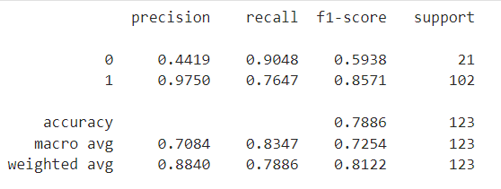
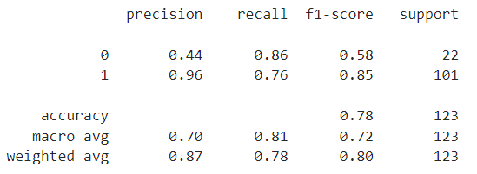
MODEL EVALUATION
Results from AutoML and conventional machine learning models were very similar.
AutoML Results
Conventional ML Results
9

Slide 10
RECOMMENDATIONS
AutoML should only be used as a starting off point to give us an idea of relationships within the data. Then a custom ML solution needs to be developed to fit Standard Bank’s specific needs.
ML forecasting when it comes to home loans does have major benefits and can speed up the time from when the application is received to when an outcome is given to the client.
Thus, the preliminary research has been a success and future research and development in this space is warranted.
10

